Slide 1

BLOCKCHAIN BASED FRAUD CONTROL AND PREVENTION PLATFORM
India ideas in action day 2017
NOV 23-24
Kiran Thumu
Sanjeev Mishra
Mahendra Mahajan
Tushar More

Slide 2
Problem Context and Statement (1 minute)
BLOCKCHAIN BASED FRAUD CONTROL AND PREVENTION PLATFORM
Context – According to data from the Federal Reserve, one of the biggest concerns among banking consumers is fraud. Global fraud resulted in losses amounting to more than $25 billion last year.
Problem Statement –Today ,there is no single shared system of all the fraud records across the FinTech industry which can be used to validate transaction in real time and prevent fraud .So, any fraudster can make same fraud in different FIs and existing systems do not have capability to prevent it. There is no mechanism to share fraud data transparently across other FIs or solution providers. By not working more closely together, they could be missing out on an opportunity to spot fraudulent behavior. As per top banks “We can only see so much of the data we have. If we use that as our only data source, we're never going to catch the large fraud rings that are stealing our customers”

Slide 3
Proposed Solution
BLOCKCHAIN BASED FRAUD CONTROL AND PREVENTION PLATFORM
Blockchain can make it possible to prevent fraud in finance. Given that ACI is already a leader in this industry and has products in Fraud prevention, ACI should build a decentralized permissioned blockchain framework of fraud records, where only verified contributors will be allowed to store, view and share digital information in a security-rich environment. As these information can be shared in real time, it can also be leveraged by the Immediate Payments Platform to reduce Fraud.
Copies of the decentralized permissioned Blockchain framework can be run by authorized parties like other Financial Solution Providers or Institutions, Choice can be made to allow the verified contributors to store the information directly or through Consensus mechanism in which information will be stored only after when all parties agree.
The information that is placed on the Block chain framework, can only be accessed by authorized parties and there will be always only one version of the information across all the copies , and only known authorized participants can verify transactions and ensure records are valid.

Slide 4
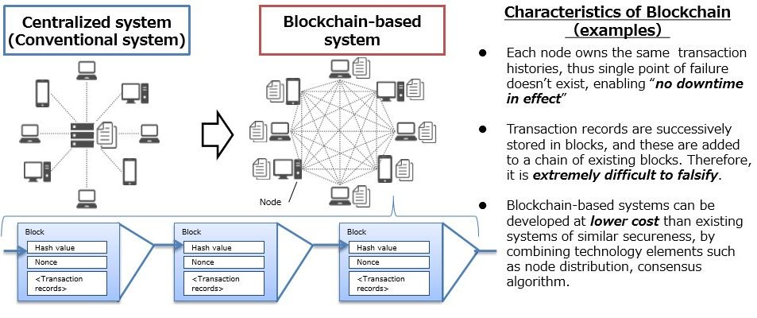
Proposed Solution (Cont..)
1642

Slide 5
Proposed Solution (Cont..)
Tools To Be Used
Networking Tool : Docker
Block chain Platform : Hyper Ledger Fabric
Frame Work : SpringBoot
Configuration :YAML
Build Tool : Gradle
SoapUI
Implementation Plan : Using Docker we will build Virtual network System on which we will deploy the Hyper ledger Fabric which is a platform that handles block chain as Frame work. With its Java SDK support we will write and deploy the chain code to add require blocks.
For time being we are going to use SoapUI tool for writing and retrieving the Fraud data to block chain.

Slide 6
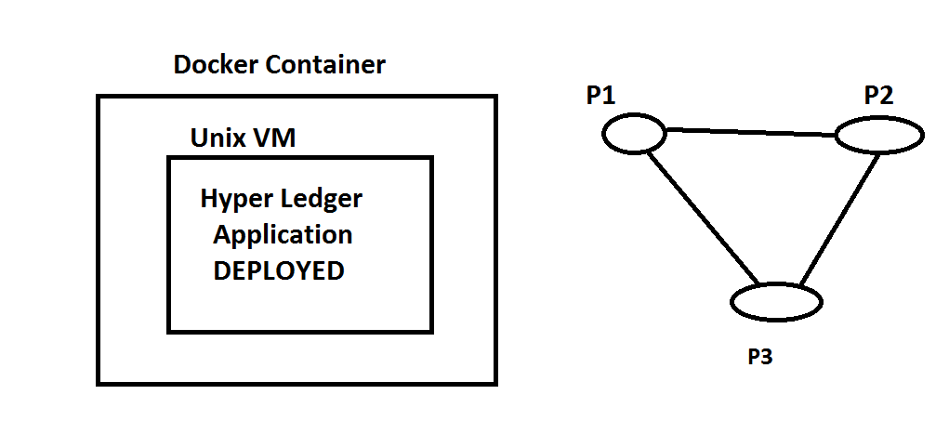
Proposed Solution (Cont..)

Slide 7
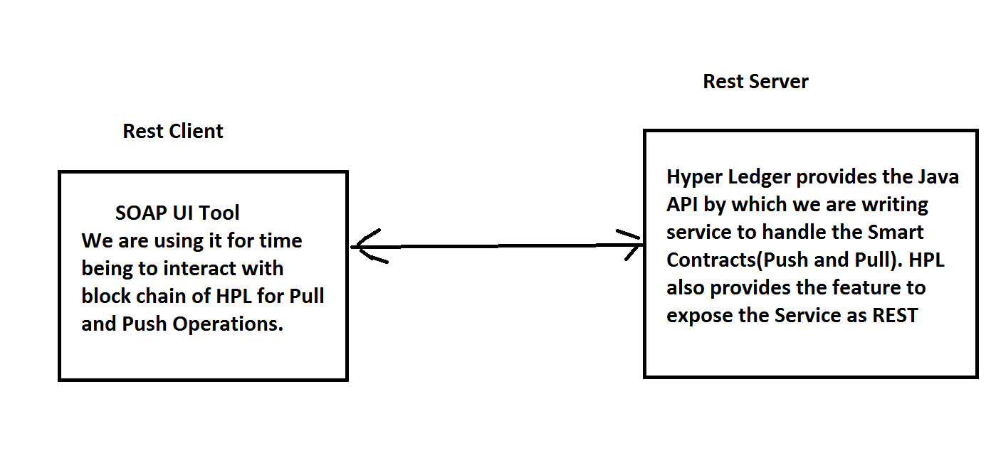
Proposed Solution (Cont..)
Hyper Ledger Framework Maintains the Network and through instructions from our service calls it handles the block chain cycle.

Slide 8
Proposed Solution (Cont..)
Implementation in POC:
As part of the POC, we deployed the Network Related Images of hyper ledger and all respective images to make the Network up and running.
On Top of it we deployed the Java Service to interact with Block chain for Log(push), Query(Pull) Operations.
Deployed Sample Java Rest services to Network and tested using Soap UI using Single Node.
Built multiple Nodes and tested push and Pull operations from each.
Every peer or Node in the Network will be identified by IP Address and Port.
Every Node in the network will push and Pull the data from Block chain. We can control these activities through configuration.
Built main Service to read Fraud data from a File and store in Block.

Slide 9
Proposed Solution (Cont..)
Challenges faced:
We faced challenges to make First network up and running on Docker VM, after downloading Hyper ledger images.
Faced Challenges in Registration and Deploying of java Service on Docker Composer.
Bigger challenge we faced is testing Service running on Hyper ledger through SOAP UI. Most of the time we were getting Socket & time out exceptions. After lot of analysis we identified and downgraded the Hyper Ledger Peer image version to 0.6.
Facing Challenges in building Swarm Service Network.

Slide 10
Benefits and Business Values
Benefits Quantified
Earn reputation for setting the trends in the industry
Will make ACI products more trustworthy
Can be use the platform in its own Immediate Payments Stack, for better fraud control.
Reduce the Fraud losses in billions .
Can be used to built multiple features like citizen credit ratting etc.
Comparison between existing method and proposed method
SunTrust, for example, has built a relationship with the Internal Revenue Service in Atlanta in which the bank sometimes calls to verify Treasury checks. The bank recently asked the IRS about one $300,000 check, which turned out to be linked to an IRS investigation, so SunTrust put the check on hold. Imagine how much benefits will our system will bring if more and more FIs , SPs and agencies(like IRS) join our proposed platform/system.
Full fledged Development Efforts Needed
Based on the agreed scope .

Slide 11
Appendix (optional)
Add additional info for detailed explanation – if asked by judges

